Slide 1
CS 106A, Lecture 26 Life After CS 106A, Part 2 [insert machine learning diagram?]
suggested reading:
none!

Slide 2
Why is this important?
insert meme of self driving car from meme page

Slide 3
Why is this important?
ML and AI are increasingly prevalent in our lives, and it’s important to at least be aware of what’s happening and how to understand the news you’re reading

Slide 4
Plan for today
What is machine learning?
Why is it useful?
Supervised Learning
Demo: k-Nearest-Neighbor
OR brief intro to regression?
What else can machine learning do?
How do we safely use machine learning?

Slide 5
Plan for today
What is machine learning?
Why is it useful?
Supervised Learning
Demo: k-Nearest-Neighbor
What else can machine learning do?
How do we safely use machine learning?

Slide 6
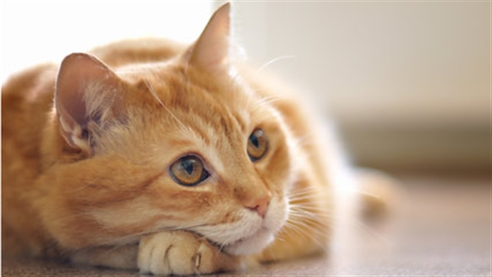
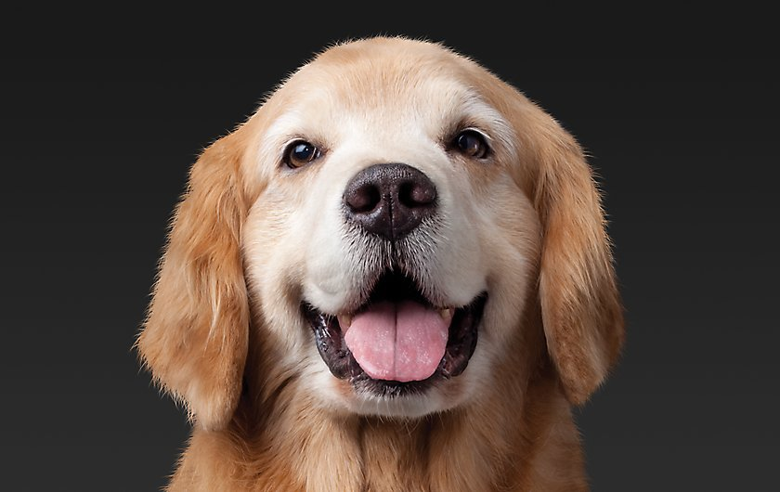
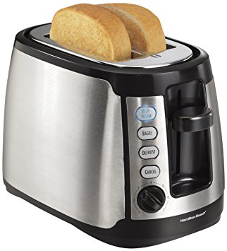
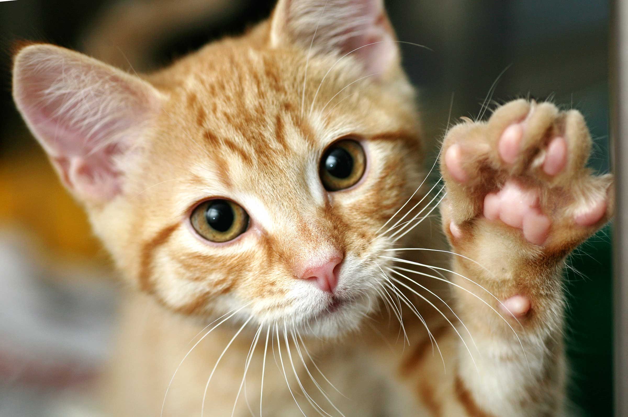
Ex: Animal Classification
We have a picture and we want to know if it’s a cat or not.
true
false
true
false

Slide 7
Ex: Animal Classification
Here’s one way you might code this…
private void isCat(GImage animal) {
int[][] pixels = animal.getPixelArray();
if (containsTwoEyes(pixels)){
if (hasWhiskers(pixels)){
if (hasPointyEars(pixels)){
return true;
}
}
}
return false;
}
Notes:
you might think of this as a series of if statements, and for a long time this is how people did predictions, more or less

Slide 8
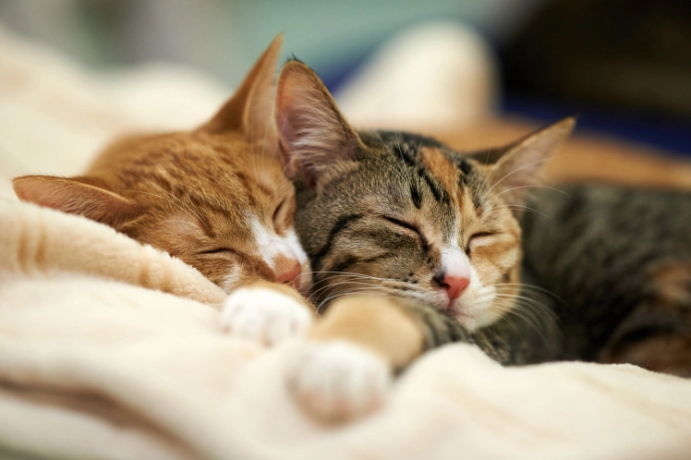

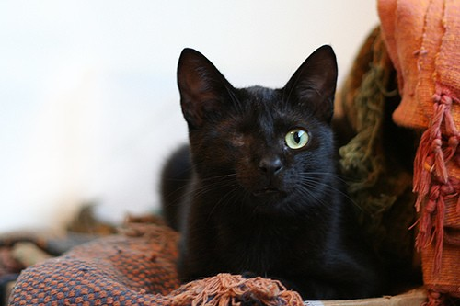
Some tricky cases

Slide 9
Pros/Cons
Pros
Matches our human intuition about what a cat is
Easy to understand the code
Cons
Requires us to explicitly enumerate every feature that’s important, and know how important it is
Need to write code to detect eyes, and whiskers, and the pointiness of ears
Will never improve… cannot learn from its mistakes

Slide 10
What is Machine Learning?
“The field of study that gives computers the ability to learn without being explicitly programmed” - Arthur Samuel, 1959
How can a computer do this?
Data.
Notes:
“How did you learn what a cat was?”

Slide 11
Plan for today
What is machine learning?
Why is it useful?
Supervised Learning
Demo: k-Nearest-Neighbor
What else can machine learning do?
How do we safely use machine learning?

Slide 12
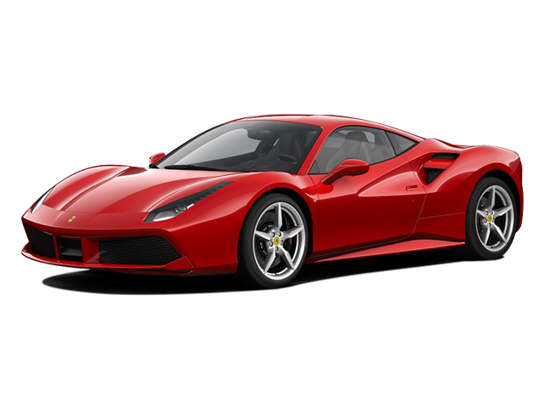
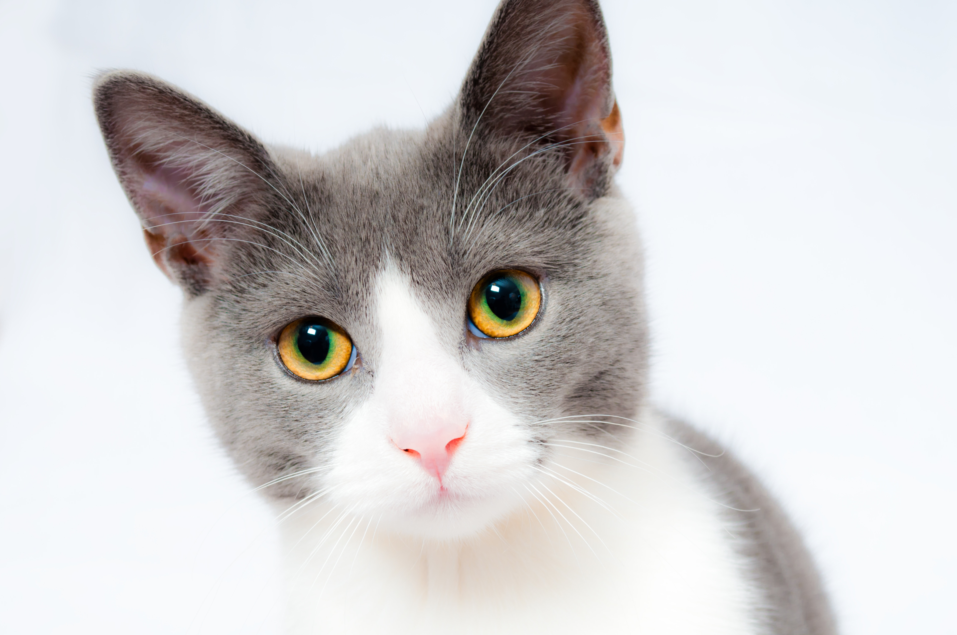
Animal Classification: Take 2
Here’s a sketch of how we can approach this problem through machine learning:
Input to the algorithm: MANY cats and MANY not-cats
For each image provided to the algorithm:
Predict whether the image is cat or not-cat
If correct, great, proceed to the next image
If incorrect, update the algorithm to do better next time
…
cat
cat
not cat

Slide 13
Pros/Cons
Pros
Doesn’t require us to explicitly tell the algorithm what’s important to distinguish between cats and not-cats
Not specific to the cat problem: we could show it images of anything and train it to learn the difference
Gets better the more data we give it
Cons
Sometimes hard to know why the algorithm makes the predictions it does
Requires us to specify an update mechanism: how is the algorithm supposed to improve itself?
Might require a lot of data to perform well

Slide 14
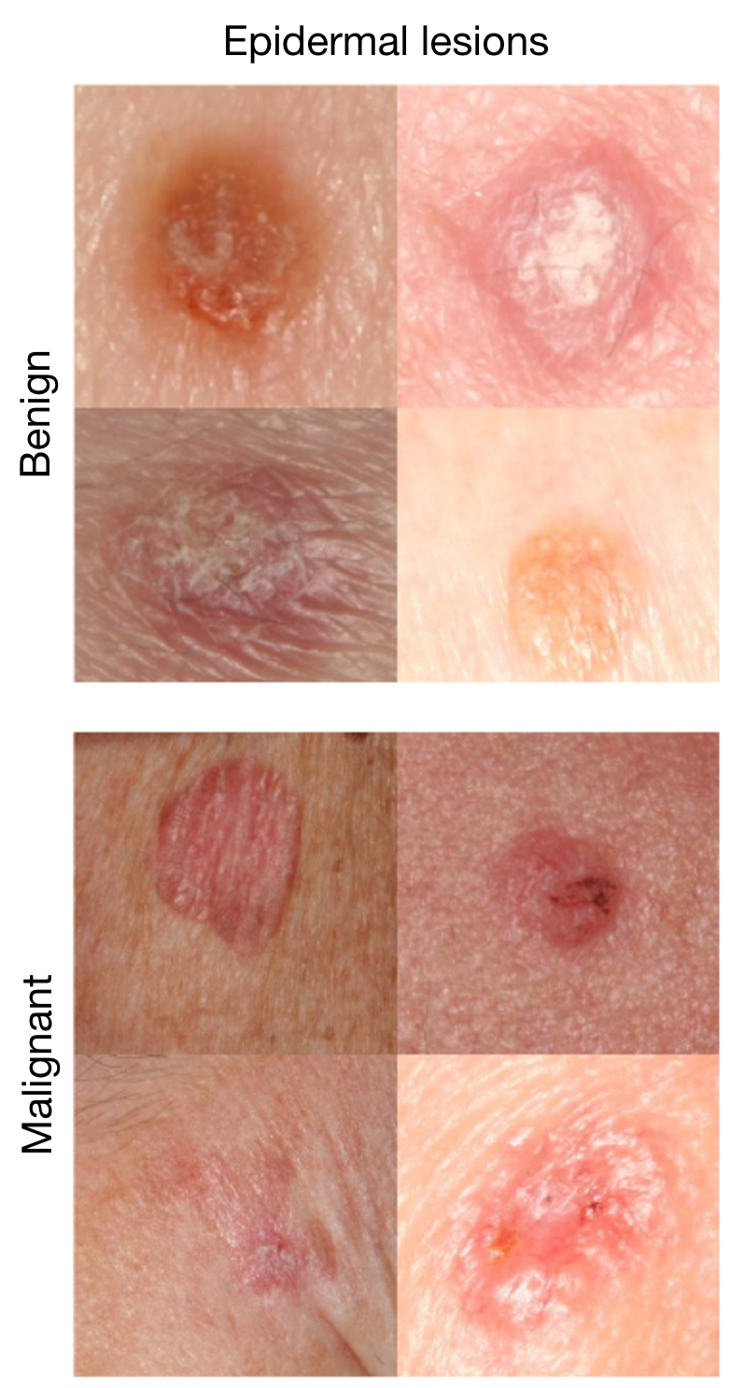
Where is this useful?
Skin cancer classification
Is a given lesion benign or malignant?
A machine learning algorithm has been shown to perform as well as dermatologists.
There are other tasks where machine learning algorithms perform better than skilled humans.
Esteva et al., Nature 2017.

Slide 15
Digit Classification
Task:
Given a picture of a handwritten digit from 0-9, predict which integer it is

Slide 16
Plan for today
What is machine learning?
Why is it useful?
Supervised Learning
Demo: k-Nearest-Neighbor
What else can machine learning do?
How do we safely use machine learning?

Slide 17
Supervised Learning
Supervised learning is when you know the “ground truth” correct answers
ex: labeling digits, skin lesions
Unsupervised learning is when you don’t – this is a much harder problem!
ex:

Slide 18
Digit Classification
Task:
Given a picture of a handwritten digit from 0-9, predict which integer it is
→ 3
→ 4
“label”
→ 2
→ 9

Slide 19
Train Data / Test Data
The algorithm gets training data that it can use to make predictions.
We use test data to evaluate how well it performs.

Slide 20
Plan for today
What is machine learning?
Why is it useful?
Supervised Learning
Demo: k-Nearest-Neighbor
What else can machine learning do?
How do we safely use machine learning?

Slide 21
k-Nearest Neighbors
Idea: when given a test image, look through all the training images to find the “closest” image.
Under the assumption that “close” images share the same label, return the label of that closest training image.
What does it mean for an image to be “close” to another image?

Slide 22
k-Nearest Neighbors
Idea: when given a test image, look through all the training images to find the k “closest” images.
Under the assumption that “close” images share the same label, return the most common label of the k closest images.

Slide 23
k-Nearest Neighbors
Given a test image T and a set of training images S:
C = k closest images to T
For each training image I in S:
distance = distance(I, T)
if distance < distance between I and the images in C:
add I to C
return most common label in C

Slide 24
k-Nearest Neighbors
TRAIN
TEST
K=3

Slide 25
k-Nearest Neighbors
TRAIN
TEST
K=3

Slide 26
k-Nearest Neighbors
Given a test image T and a set of training images S:
C = k closest images to T
For each training image I in S:
distance = distance(I, T)
if distance < distance between I and the images in C:
add I to C
return most common label in C

Slide 27
k-Nearest Neighbors demo!
nothing to see here, carry on ☺

Slide 28
Aside: update mechanisms
At a high level:
Calculate how wrong a prediction was
Determine what contributed most to the wrong prediction
Adjust the model so it will be less wrong in the future
At a low level, lots of linear algebra!

Slide 29
Plan for today
What is machine learning?
Why is it useful?
Supervised Learning
Demo: k-Nearest-Neighbor
What else can machine learning do?
How do we safely use machine learning?

Slide 30
What else can ML do?
Supervised Learning
Classification, like the cat or skin cancer or digits examples
Regression

Slide 31
Regression Example
House price prediction
Training Data
Test Time
Square Footage | House Price
1,000 | 150,000
1,256 | 175,000
5,897 | 2,000,000
4,300 | 1,300,000
2,400 | 750,000
2,600 | 690,000
3,000 | 1,000,000
“My house has 1,800 square feet. How much should I expect it to sell for?”

Slide 32
Regression Example
Poverty from nightlights
Training Data
Test Time
“My house has 1,800 square feet. How much should I expect it to sell for?”

Slide 33
What else can ML do?
Supervised Learning
Classification
Regression
Unsupervised Learning
Finding structure in unlabeled data

Slide 34
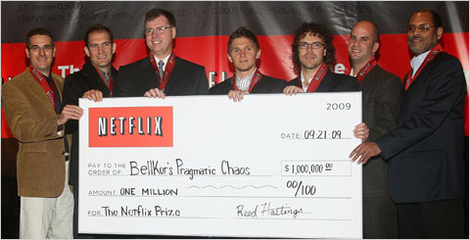
Netflix Prize Example
Netflix Prize

Slide 35
What else can ML do?
Supervised Learning
Classification
Regression
Unsupervised Learning
Reinforcement Learning

Slide 36
AlphaGo

Slide 37
What remains really hard?
Human-like dialog
Common-sense reasoning about the world
Strong generalization
Learning to learn
… and much else ☺

Slide 38
Plan for today
What is machine learning?
Why is it useful?
Supervised Learning
Demo: k-Nearest-Neighbor
What else can machine learning do?
How do we safely use machine learning?

Slide 39
Algorithmic bias
Court sentencing example, word2vec example
importance of DATA

Slide 40
Artificial Intelligence
quote from Elon Musk about his fear of AI
Google’s Pentagon contract (autonomous killing drones)

Slide 41
Recap
ML is powerful because it can learn from data, without explicit instruction
… but because of that, is subject to the same flaws found in data
… and must be used safely
[insert cute graphic here]

